Slide 1

Calendaring software
Final presentation
Navya 1602-19-737-143
Bhavani 1602-19-737-173

Slide 2

In today’s world most of us are dependent on the calendar for various purposes. We have decided to make your work more easier and efficient with our calendaring software. It is a software that minimally provides users with an electronic version of a calendar. This application will be built on the console without using graphic properties; instead, it utilizes many other window properties to give the application a colourful look and feel. Our software would enable the users to add notes , remainders and it enables the user to prepare a to-do list for a particular day with the time slots assigned. The software also enables the user to check for overlapping events etc features. GITHUB LINKS: https://github.com/navyashruthi15 https://github.com/bhavanisilasagaram
ABSTRACT

Slide 3
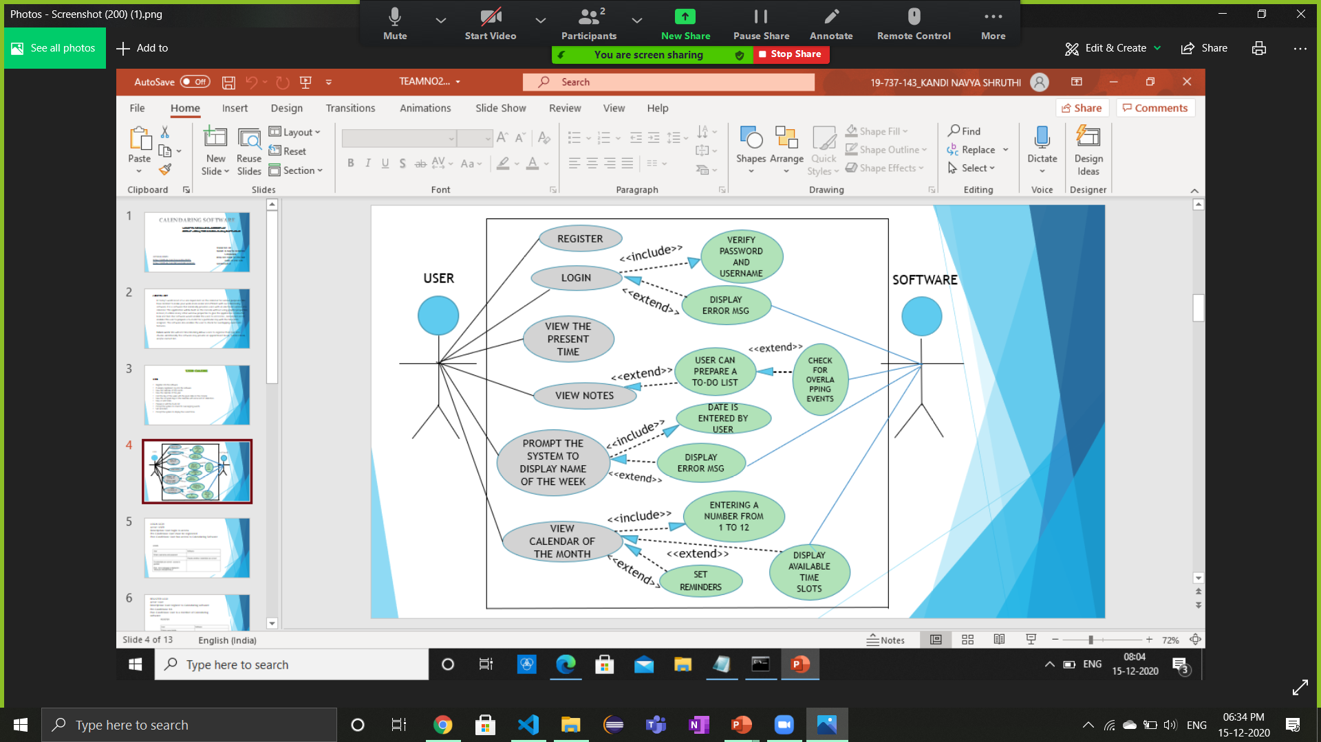
USE CASE DIAGRAM

Slide 4

Technology used
GCC compiler
Vs code
VIM
C language

Slide 5
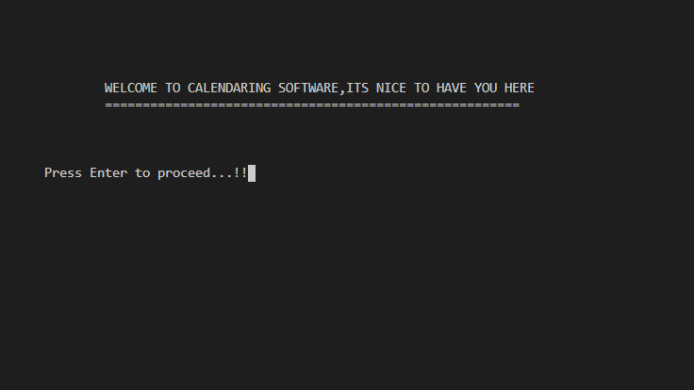

Slide 6
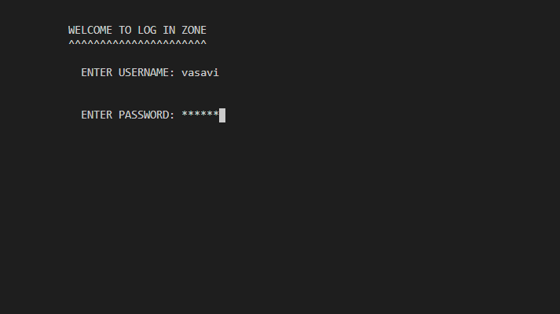

Slide 7
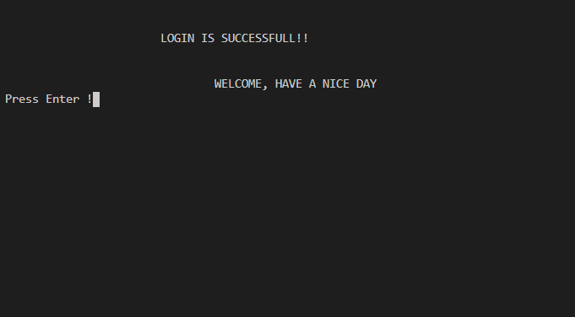

Slide 8
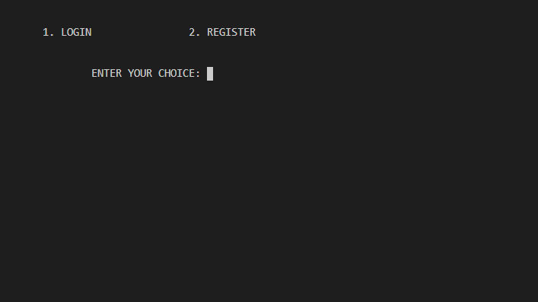

Slide 9
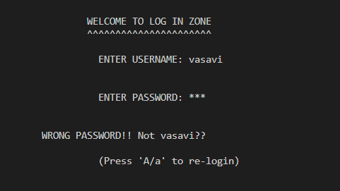

Slide 10
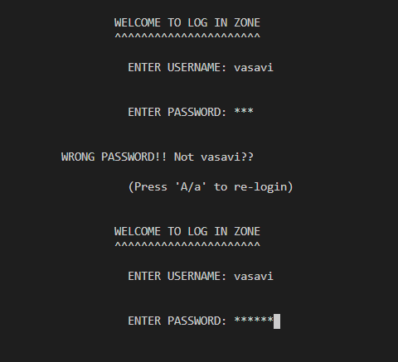

Slide 11
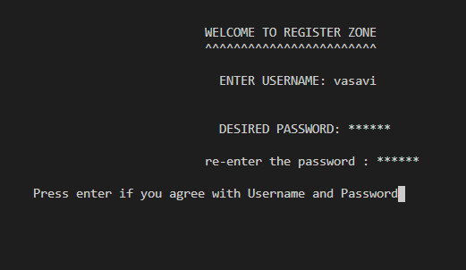

Slide 12
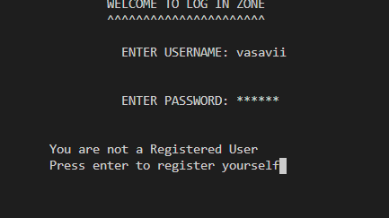

Slide 13
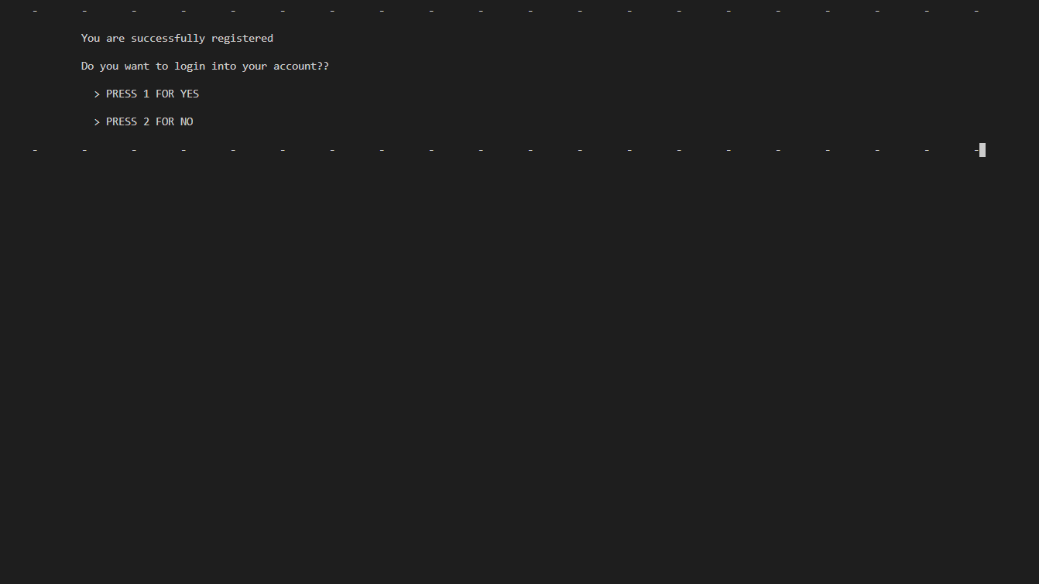

Slide 14
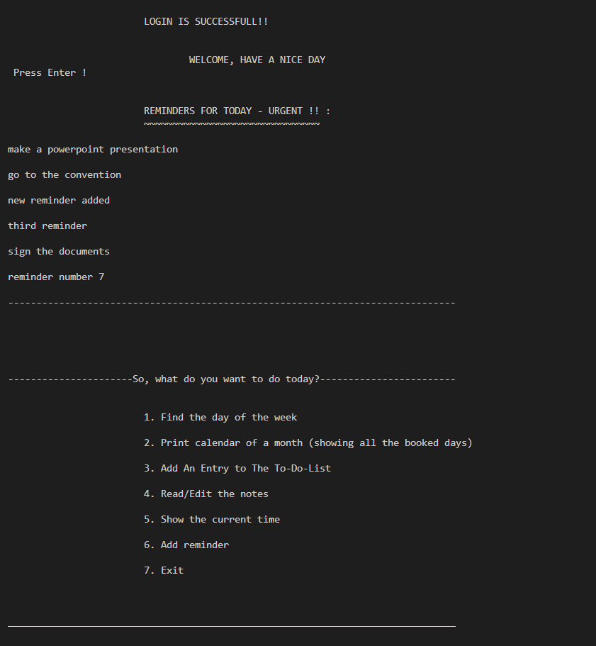

Slide 15
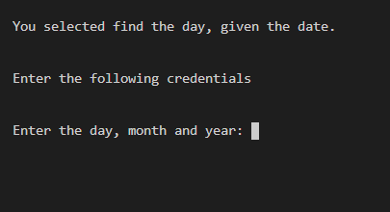

Slide 16
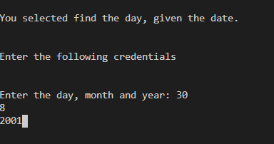

Slide 17
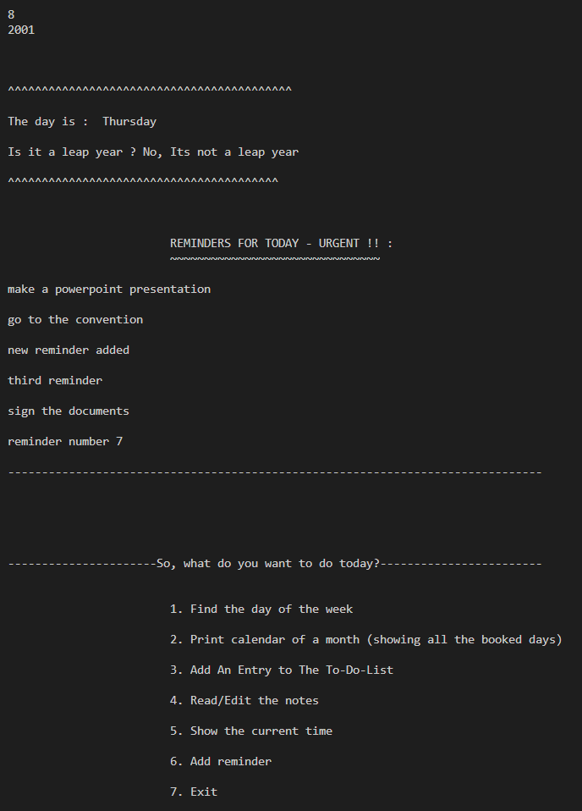

Slide 18
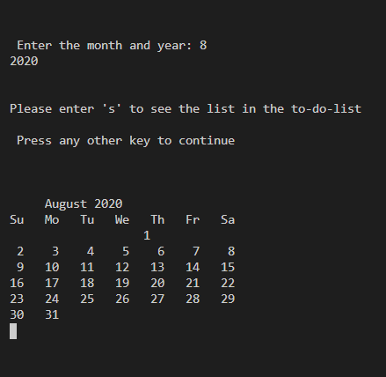

Slide 19
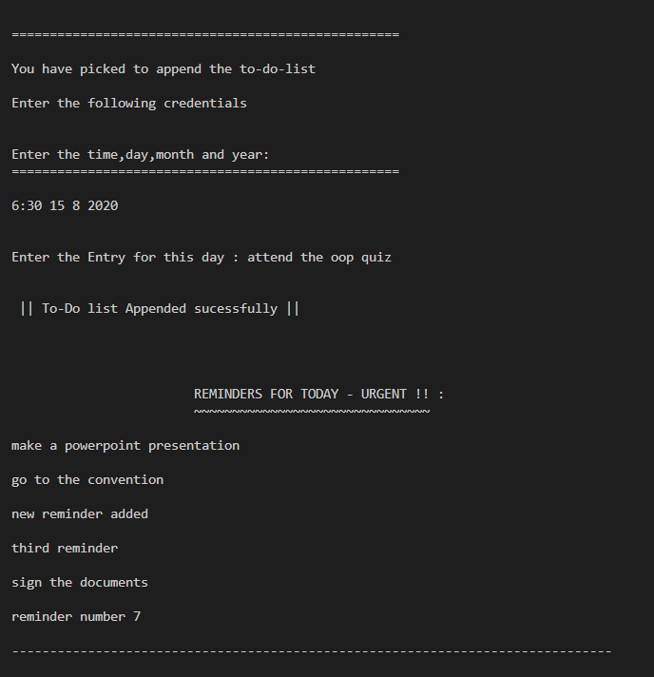

Slide 20
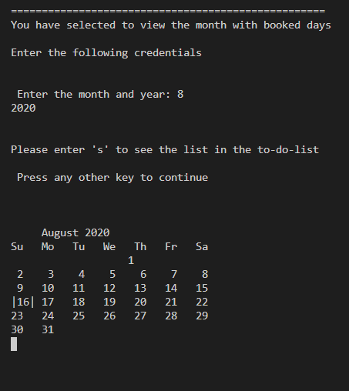

Slide 21
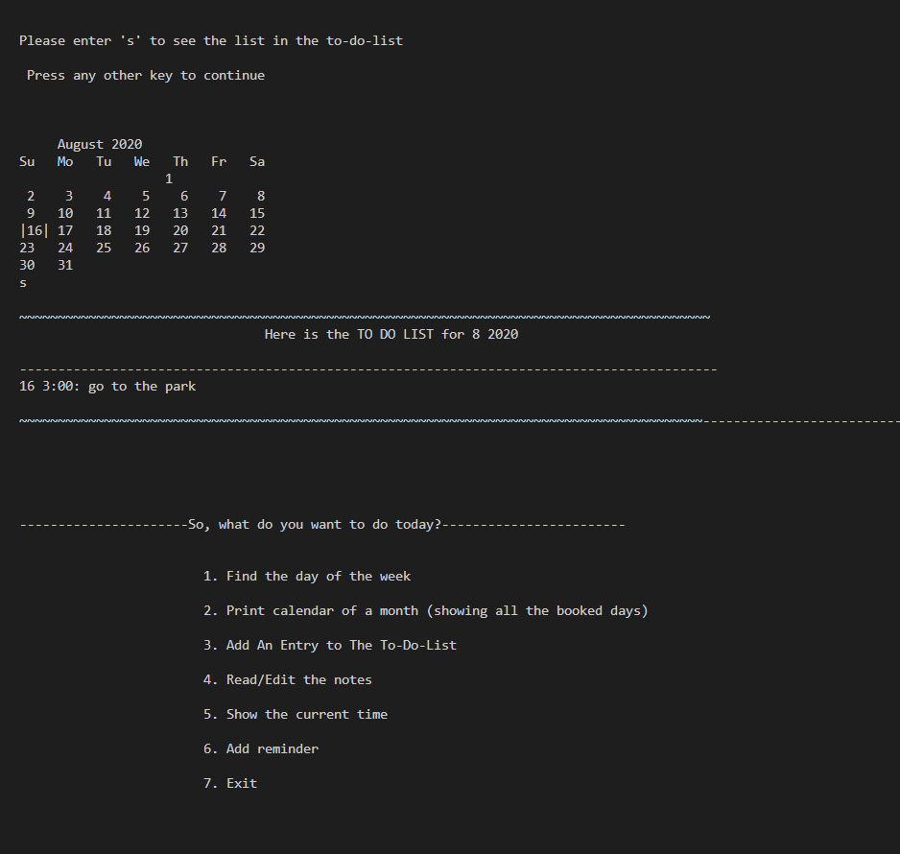

Slide 22
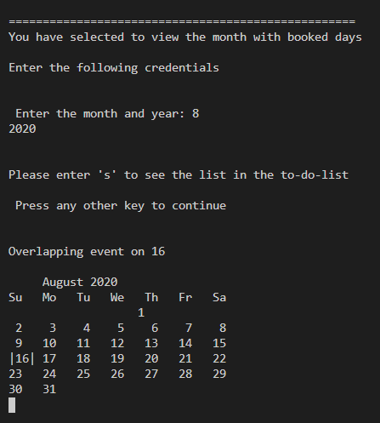

Slide 23
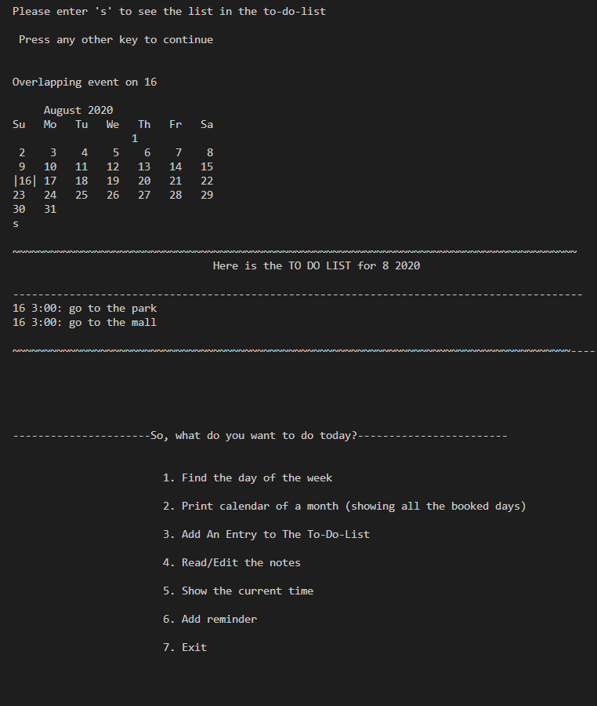

Slide 24
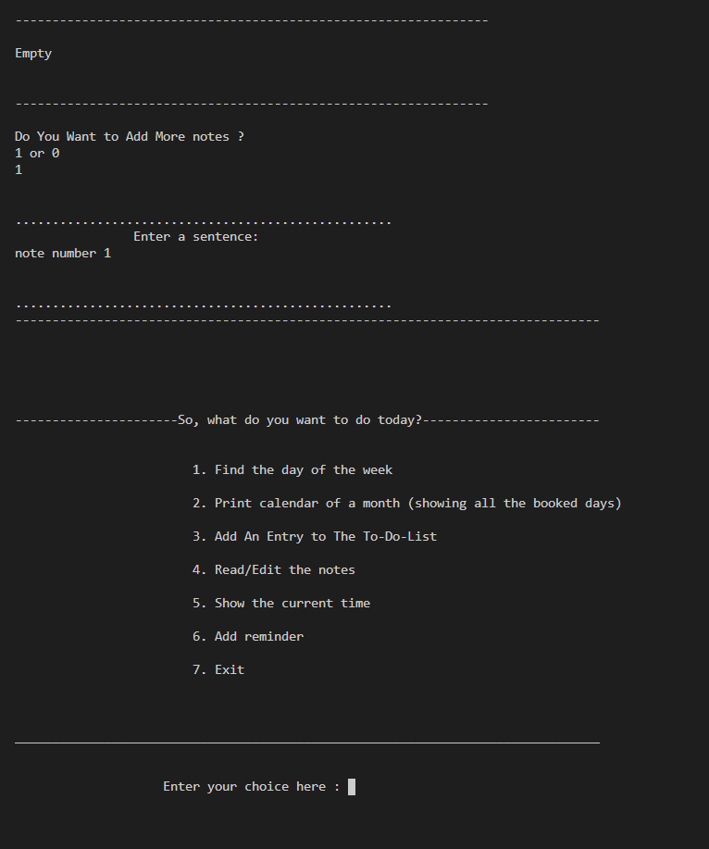

Slide 25
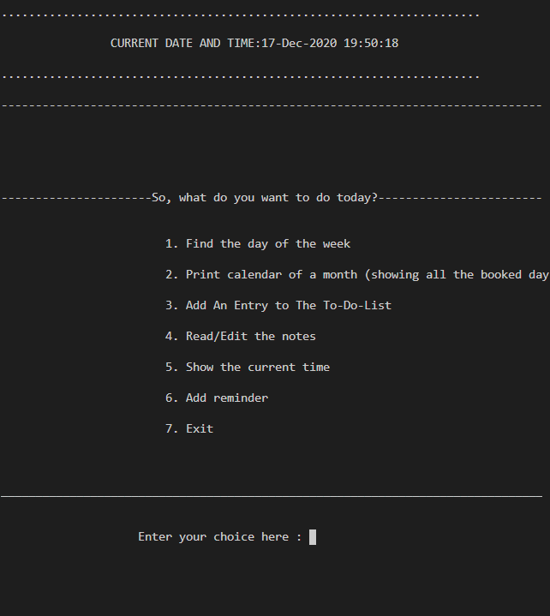

Slide 26
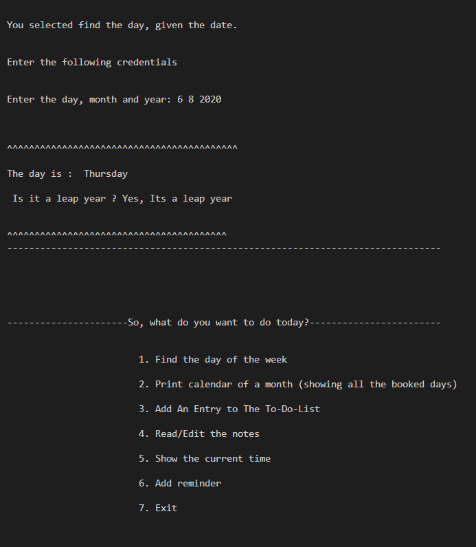

Slide 27

CONCLUSION
We have gained immense knowledge in coding and programming throughout the duration of this miniproject. The joy of working and thrill involved while debugging and fixing errors gave us a feel of being an actual software developer. We have improved our collaborating skills.
Even though we faced challenges during the coding phase, we helped each other out and finally achieved the desired product. It was a wonderful opportunity for both of us, and we will be looking forward to many more such opportunities in the future

Slide 28
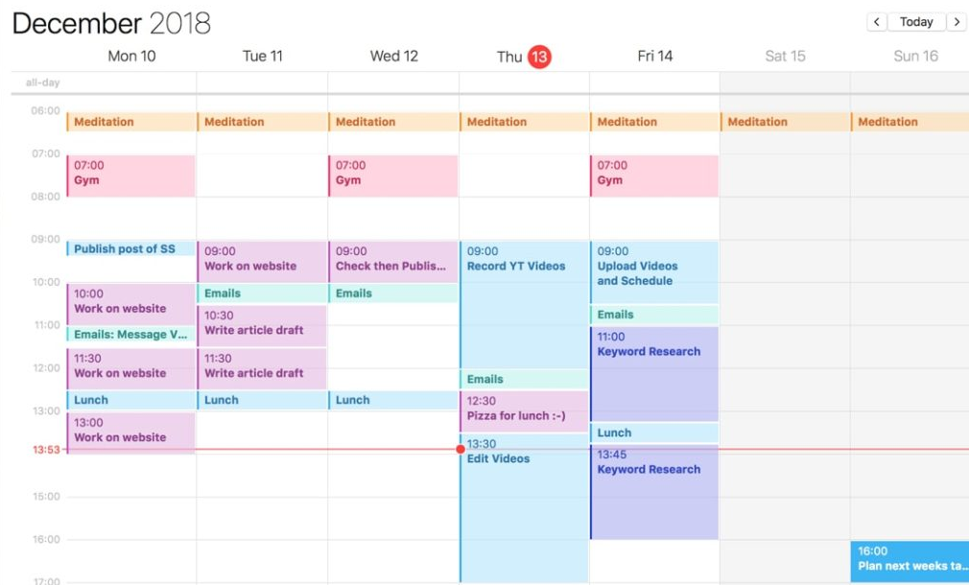
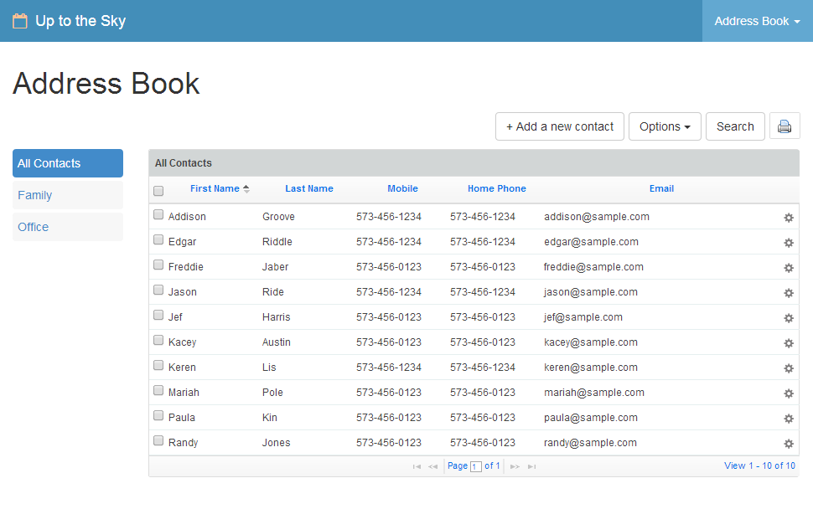
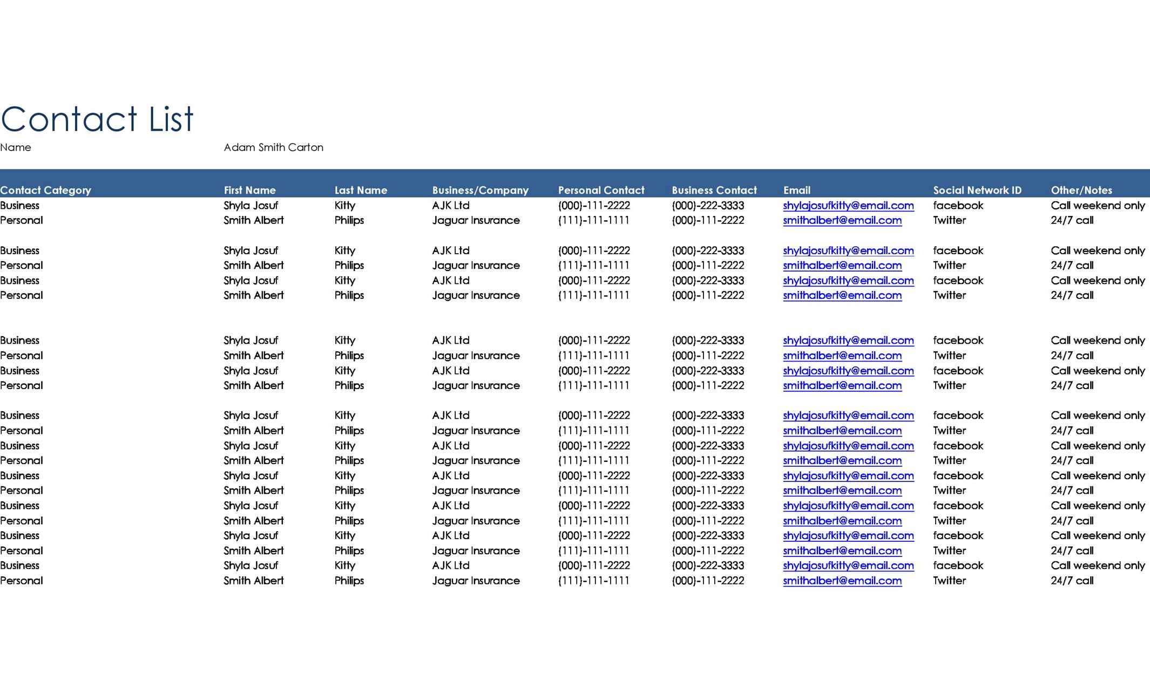
FUTURE GOALS
Organizing Chunks
And Time Blocking
Time-wise chunks can be allocated.
Date wise chunks can be organized
Address book
Contact list

Slide 29


THANK YOU
Navya Bhavani
kandinavyashruthi@gmail.com
Bhavani.sila@gmail.com

